Slide 1
What London needs…
Pre-release report headlines
12 January 2021

Slide 2
What we’ll do this morning
Share headlines from our upcoming report
    Remember: what were we focusing on before the crisis?
    Respond: what have we seen through the crisis period?
    Recover: what’s on the horizon for London’s recovery?
    Rethink: what scenarios could we face in the future?
Discuss what this means for funders and civil society
    Briony Williamson, Consortium
    Farah Elahi, Greater London Authority
    Fiona Rawes, City of London Corporation/City Bridge Trust
    Manny Hothi, Trust for London
Update you on the London Community Response
    Wave five: next steps with crisis response and renewal grants

Slide 3
What London needs…
Remember

Slide 4
Local and regional priorities
Review of all local authority JSNAs as at the start of 2020
  The Joint Strategic Needs Assessment (JSNA) is a process by which local authorities and Clinical Commissioning Groups assess the current and future health, care and wellbeing needs of the local community to inform local decision making
Review of key regional strategies and plans from the Mayor of London, GLA and London Councils, as at the start of 2020

Slide 5
Review of JSNAs
All JSNAs were read and key points listed
Priorities were grouped:
  Health (e.g. substance misuse)
  Structural (e.g. affordable housing)
  Children and young people (e.g. skills)
  Social capital (e.g. volunteering)
  Over 65s (e.g. fuel poverty)
  Safety (e.g. hate crime)

Slide 6
JSNAs – key issues grid

Slide 7
JSNAs – the priority list
The top ten most common priorities across JSNAs are:
  1. Exercise & physical activity (appearing as a priority across 25 JSNAs)
  2 = Social care (21)
  2 = Affordable housing (21)
  2 = Substance abuse (21)
  5 = Housing standards (20)
  5 = Mental health (20)
  5 = Safer alcohol habits (20)
  8. Reducing smoking (19)
  9 = Screenings and health checks (18)
  9 = Social isolation (18)

Slide 8
Key regional strategies & plans
London Councils – pledges to Londoners (2018)
GLA survey of Londoners (2019)
MOPAC strategy (2019)
Talk London report (2019)
The Mayor of London’s strategies….

Slide 9
The Mayor’s strategies and plans
Strategy mapping report (2019)
Social integration (2018)
Tackling VAWG 2018-21 (2017)
Careers for Londoners Action Plan (2018)
Culture strategy (2018)
Cultural infrastructure plan (2018)
Cycling action plan (2018)
Economic Development Strategy (2018)
Environment strategy (2018)
Sustainable draining plan (2016)
Freight and servicing action plan (2018)
Health inequalities strategy (2018)
Rough sleeping action plan (2018)
London housing strategy (2018)
London Safety Plan (2017)
Vision for London as a 24 hour city (2017)
Skills for Londoners strategy (2018)
Smarter London Together (2018)
Sport and physical activity strategy (2018)
Solar action plan for London (2018)
Taxi and private hire action plan (2016)
Equality, diversity and inclusion strategy (2018)
London Food Strategy (2018)
London Knife Crime Strategy (2017)
Police and Crime plan (2017)
Transport Strategy (2018)
Vision Zero Action Plan (2018)
Walking Action Plan (2018)

Slide 10
Review of regional strategies
All documents on the list were read and key points listed
Priorities were grouped using same headings as JSNAs, but some different sub-headings:
  Health (e.g. mental health)
  Structural (e.g. affordable housing)
  Children and young people (e.g. early years)
  Social capital (e.g. volunteering)
  Over 65s (e.g. fuel poverty)
  Safety (e.g. legal aid)

Slide 11
Regional – key issues grid

Slide 12
Regional – the priority list
The top ten issues across the public bodies are:
  1. Air quality and environment (mentioned by 12 bodies)
  2. Public safety (10)
  3 = Affordable transport (9)
  3 = Community (9)
  5 = Housing standards (8)
  5 = Discrimination & Hate crime (8)
  7. Affordable housing (7)
  8 = Accessibility (5)
  8 = Cost of living (5)
  8 = Road safety (5)
  8 = Skills training (5)
  8 = Social isolation (5)

Slide 13
Local and regional links
Some themes are present in both the local and the regional strategies, and are also issues we’ve seen have an impact during the times of crisis of the last year
The top three issues with links between the local and the regional are:
  Affordable housing
  Housing standards
  Social isolation

Slide 14
London Funders mapping 2019
Survey of members to identify how much funding was distributed, where, on what
£0.5bn of funding mapped
All sectors of membership responded, covering grants, social investment and commissioned services

Slide 15
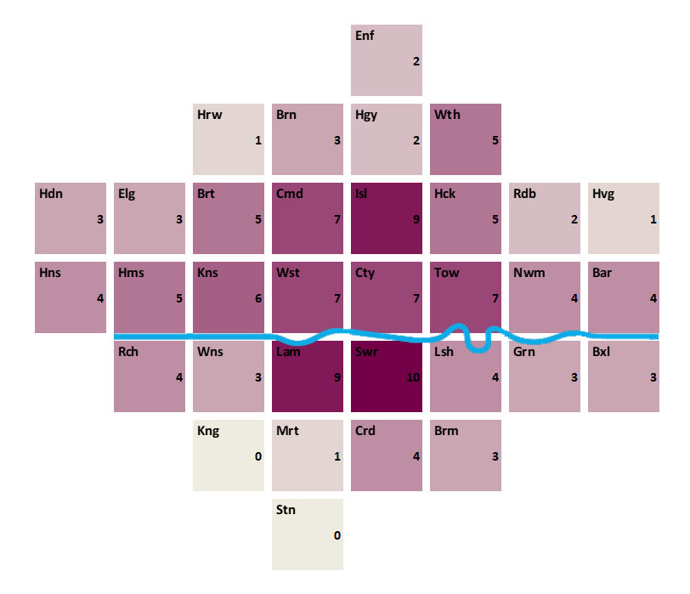
Hot and cold boroughs?

Slide 16
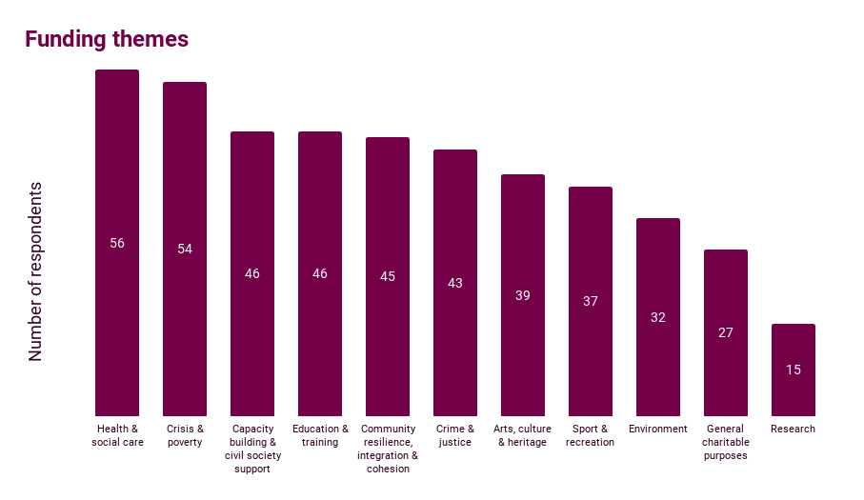
Focus themes?

Slide 17
Where funding went
Strong funding for children and young people, and crisis and poverty
“Cold spot” boroughs in outer ring
Links across to charity density – e.g. fewer charities in outer London boroughs
Interest from members in looking to challenge and change where funding went

Slide 18
What London needs…
Respond

Slide 19
Regular survey of civil society
Survey to civil society groups for 8 months
Core questions across surveys for tracking
Topical questions to focus on key issues
Data available on the London Datastore

Slide 20
Challenges facing Londoners

Slide 21
Challenges facing civil society

Slide 22
Patterns of demand
Increase in numbers seeking support
Notes:
This week 56 per cent of responding organisations (63) saw an increase in the number of people seeking support in the last two weeks.
43 reported little change in numbers and 7 reported a decrease.
Organisations working with BAME Londoners were more likely to report increased need at 60%. Organisation working with young people were significantly less likely to report higher demand at 29%.

Slide 23
London Community Response
Funding from 67 funders
£46m+ distributed since March 2020
Four waves of funding completed using common application form – providing single data set on over £150m of asks from over 8,300 civil society groups across London
Further work to come on reviewing learning and shared understanding of impact

Slide 24
Wave three: focus on equity
73.5% of total grants went to groups led by focus communities

Slide 25
LCR: grant themes (totals)

Slide 26
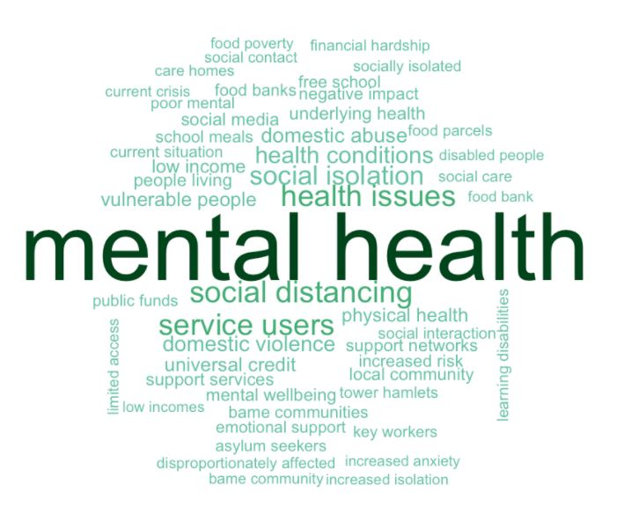
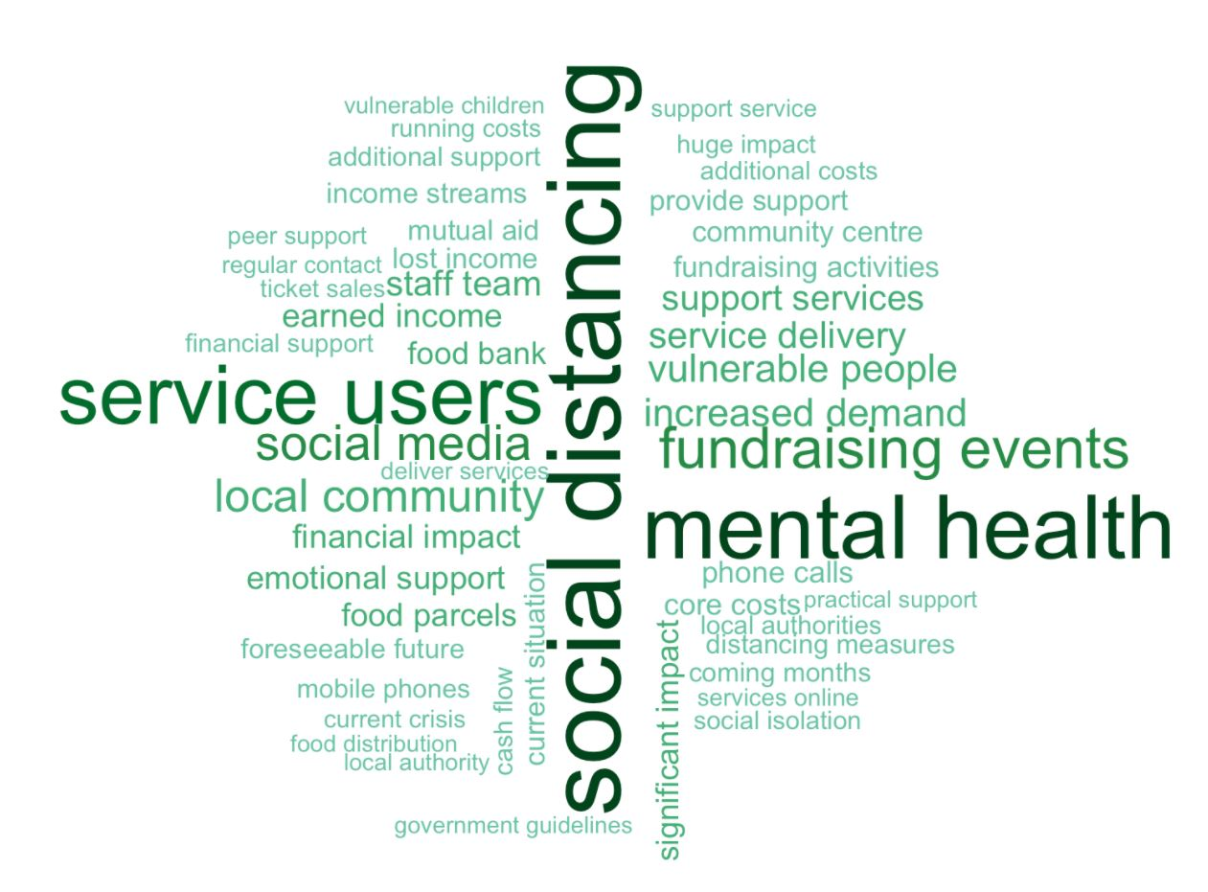
LCR: hidden themes

Slide 27
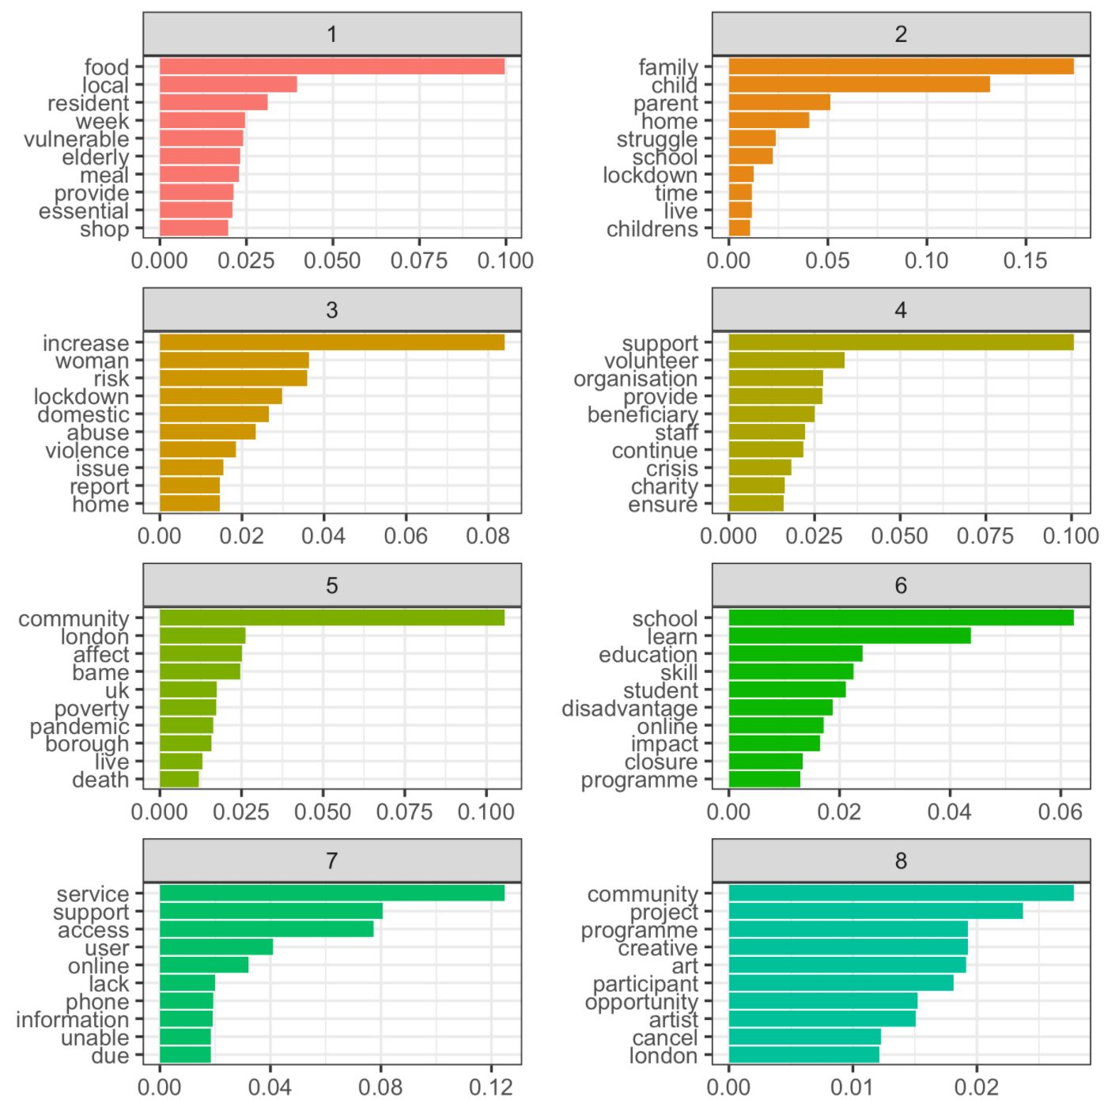
LCR: topic modelling (1)

Slide 28
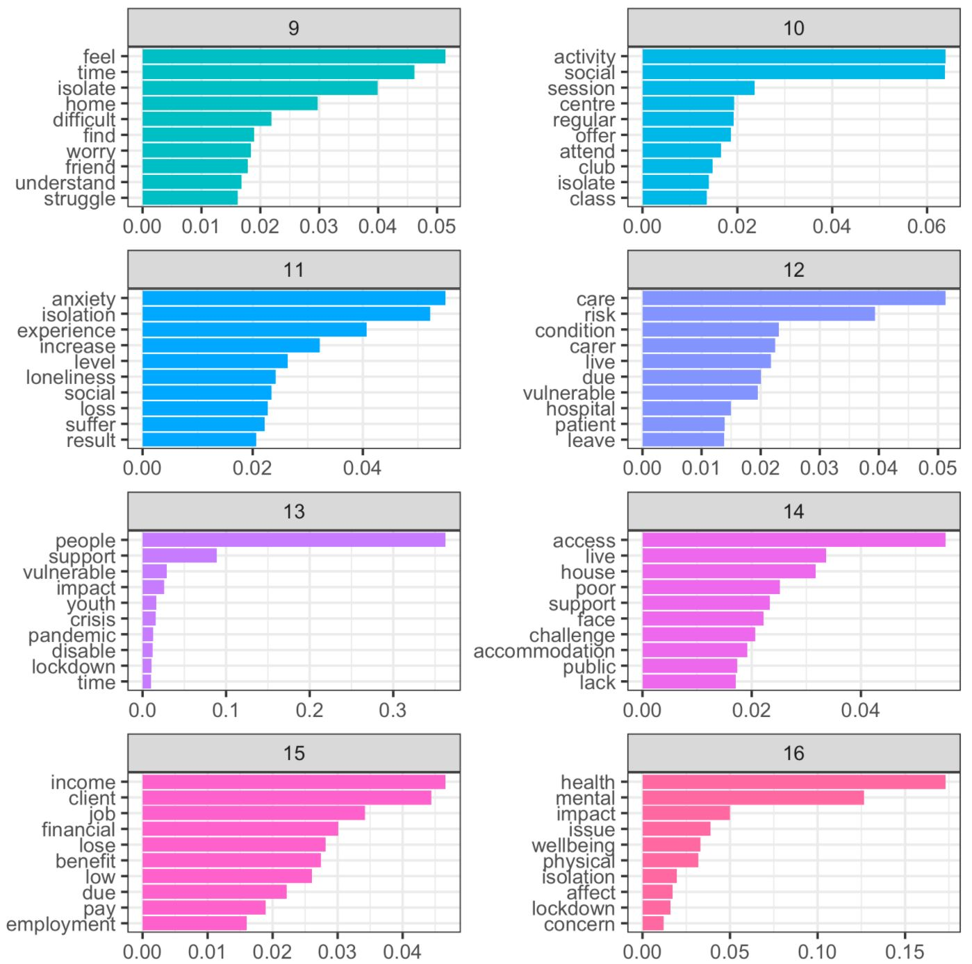
LCR: topic modelling (2)

Slide 29
LCR: topic modelling summary
Sixteen thematic groups emerge:
  Food/essentials for vulnerable
  Family, children, school
  Domestic violence
  Voluntary work
  Types of communities (London, BAME)
  Education
  Support services
  Creative projects
  Feelings
  Social activities
  Anxiety and isolation
  Carers, healthcare
  People
  Public infrastructure/housing
  Income
  Mental health

Slide 30
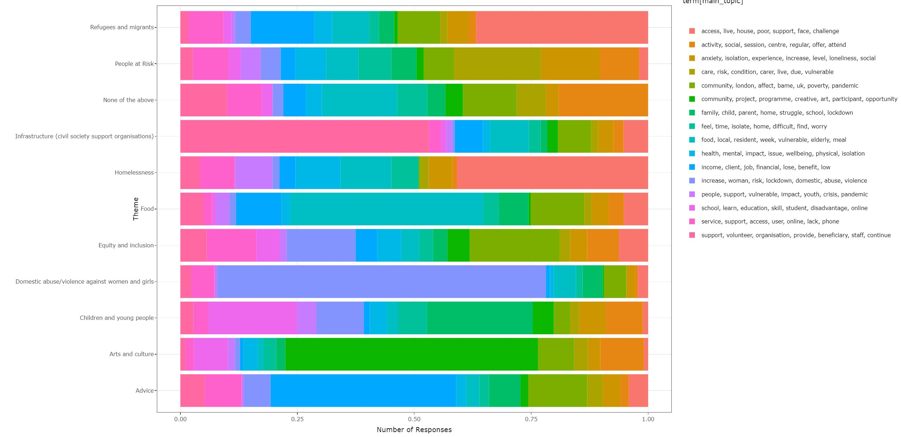
LCR: topic v. theme

Slide 31
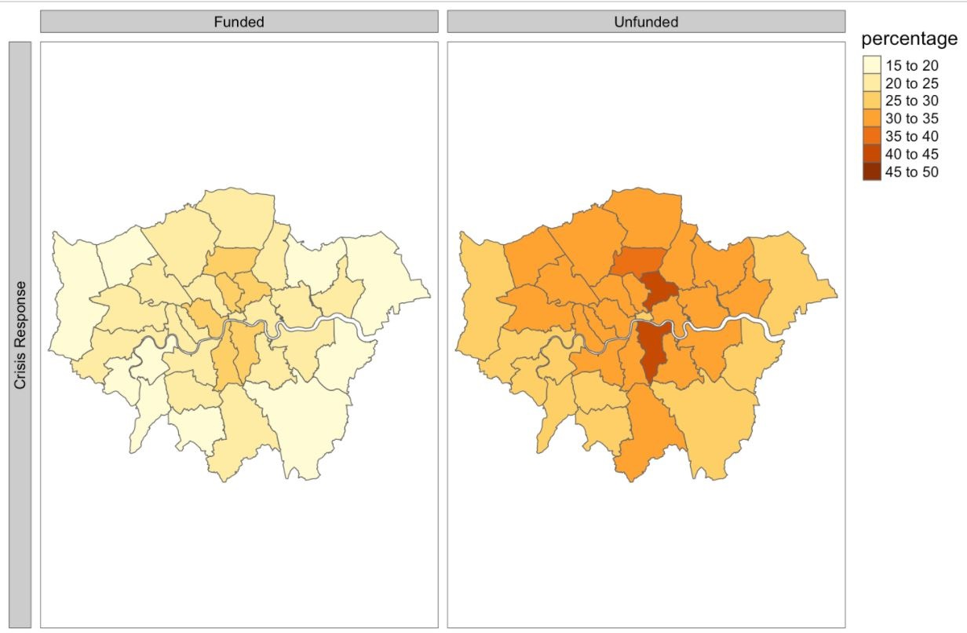
Small grants by borough

Slide 32
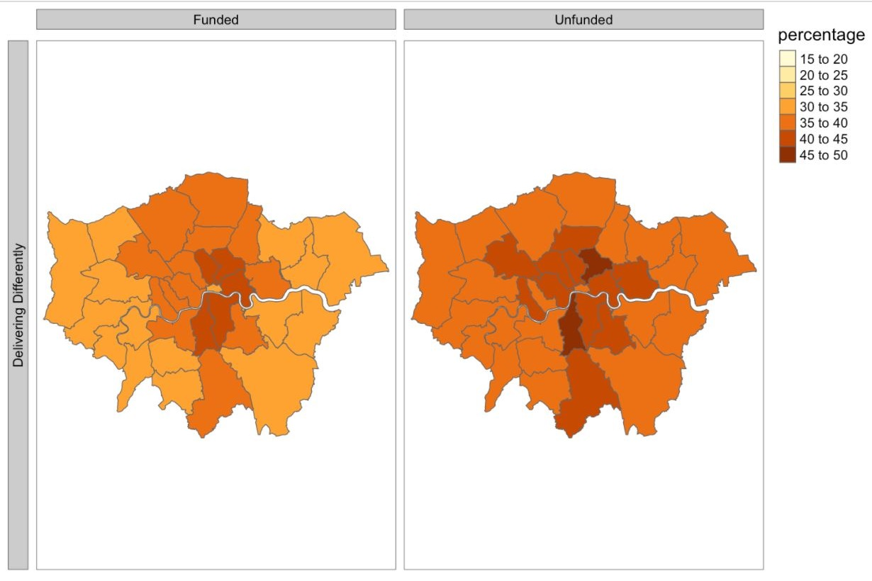
Large grants by borough

Slide 33
Needs v funding
Use of data and insight from surveys, funders, research reports (curated list of key info in covid-19 resource hub) and applications to inform funding decisions
Shifting priorities through London Community Response linking to changing priorities from civil society groups and communities
Learning partner work to explore how we can build from this for the future

Slide 34
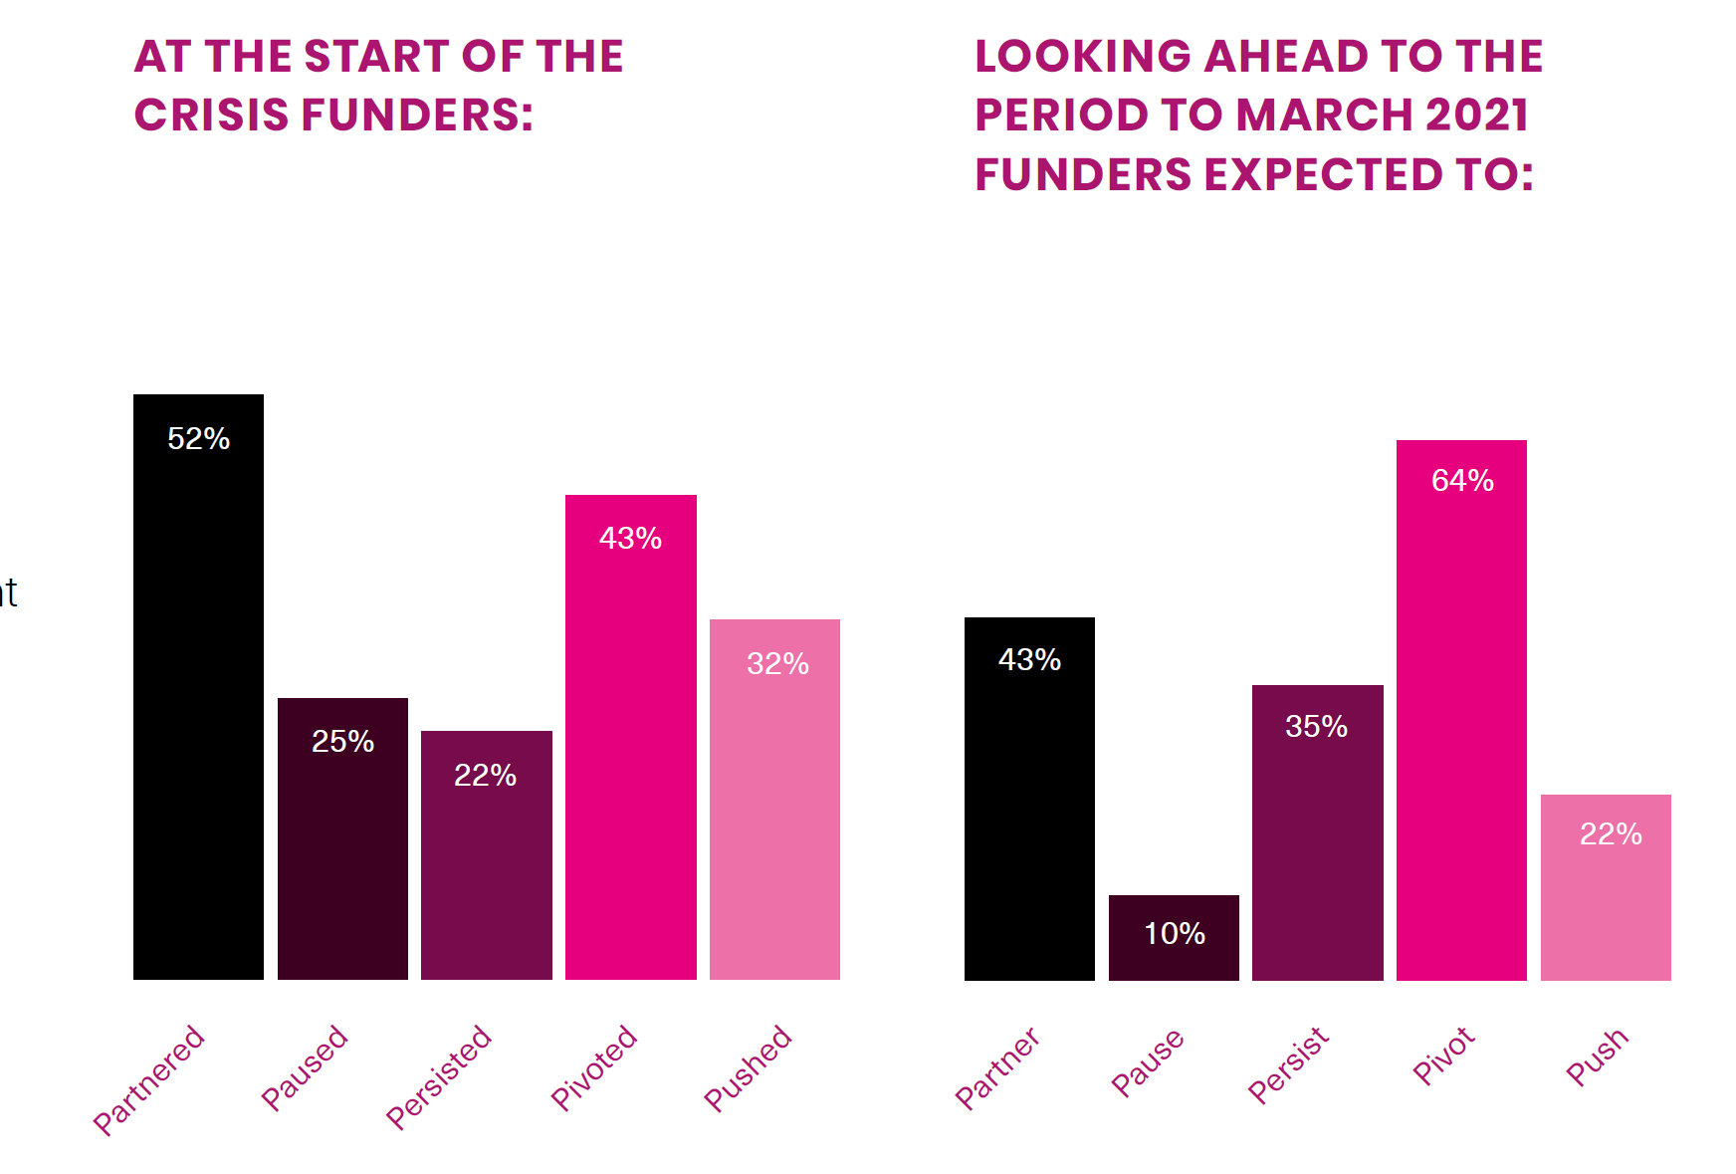
How is funder mood changing?

Slide 35
What London needs…
Recover

Slide 36
London Recovery Board
Chaired by the Mayor and the Chair of London Councils, this brings together leaders from across London’s government, business and civil society, as well as the health and education sectors, trade unions and the police, to oversee the long-term recovery effort.
Its aims are to:
  reverse the pattern of rising unemployment and lost economic growth caused by the economic scarring of COVID-19
  support our communities, including those most impacted by the virus
  help young people to flourish with access to support and opportunities
  narrow social, economic and health inequalities
  accelerate delivery of a cleaner, greener London

Slide 37
Challenges and opportunities
£10.1bn funding gap in next six months
1 in 10 Londoners have no digital skills
30% of capital’s workforce furloughed
  One third of 18-24 year olds furloughed or made redundant, twice that of over-24’s
148% increase in out of work benefit claims
177% increase in emergency food parcels
90,000+ Londoners registered NHS volunteers
Over 700 Mutual Aid groups in March ‘20

Slide 38
The missions
High streets for all
Building strong communities
Digital access for all
A green new deal
A robust safety net
A new deal for young people
Healthy food, healthy weight
Good work for Londoners
Mental health and wellbeing

Slide 39
Example: strong communities
By 2025, all Londoners will have access to a community hub ensuring they can volunteer, get support and build strong community networks
  All communities - particularly the most disadvantaged with the greatest health inequalities - can get the support and services they need. They should also have more control and choice over those services.
  Londoners can build and maintain relationships and be active citizens.
  London’s civil society is strong and resilient. It reflects and champions London's communities and can meet future shocks. Organisations can access resources and support to meet new/changed demand and provide essential services.
  Sustainable and strong partnerships between funders and voluntary and community sector organisations.
  Continuing risks that arose during the crisis are addressed.
  Public service partnerships proactively include the voice of older Londoners in future planning.

Slide 40
Recovery as a focus for funding?
Mission approach being adopted for wave five of the London Community Response
Focusing in on three missions:
  Building strong communities
  New deal for young people
  Robust safety net
Opportunities to look at total assets approach, linking funding outcomes to work of public sector bodies, volunteering and community assets

Slide 41
What London needs…
Rethink

Slide 42
Looking ahead
Reos Partners commissioned through the London Community Response (thanks to funding from City Bridge Trust/LCRF, the Paul Hamlyn Foundation, the GLA, United Saint Saviour’s and the London Community Foundation) to help us answer the question: What should the key areas of focus be as we look towards renewal?

Slide 43
Developing scenarios
The scenarios tell stories of four possible futures for London’s communities in the year 2023.
The purpose of these scenarios is not to predict the future, but rather to shed light on the threats and opportunities facing London’s communities.
They are meant to be: plausible, relevant, challenging and clear

Slide 44
Engagement with the scenarios
These scenarios were informed by:
  Survey responses from over 500 grant recipients and 36 funders
  Interviews with 5 key stakeholders working with London’s communities
  A review of several other scenarios - especially the Centre for London’s “London at a Crossroads”
  A participatory workshop with 10 funders
  A participatory workshop with 40 groups

Slide 45
1. Building back the same
This is a story about going back to the way things were; rebuilding the economy, yet not fully recovering as a society. The government is working to get things back to the way they were, and is focused on reclaiming Central London’s prestige as the bustling capital and economic centre of Great Britain.
  Central Themes:
    Economy; Governance, Poverty, Inequality, and Food Security; Education.
  Tone:
    This scenario is characterized by polarity, division, siloed thinking, greed, economic stability, and capitalism. In this scenario there are a few who are thriving, many who are surviving, and some that can barely survive.

Slide 46
Implications for funding
To avoid the harmful elements of the scenario world of “Building Back the Same” and advance a future that meets the needs of all of London's communities this scenario would require funders to:
  Carefully target resources (using data to do so) to support young people, BAME, Deaf and Disabled, and LGBT+ communities.
  Invest in campaigning, lobbying, advocacy and systems change alongside direct delivery, as well as considering their own role in those activities.
  Work in collaborative, pro-active ways - building on what funders have built through the LCR and not returning to old ways of working.
The scenario could also provide funders with more resources (as their investments or income streams would do well) but would require them to be more thoughtful about how that money is invested and about who holds power/makes decisions.

Slide 47
2. Building back better
This is a story about connection and regeneration. It is about taking advantage of the disruption of this moment to build forward better by collaborating and rethinking how society operates. It is a reorganisation of the economy, a shift in the public and government thinking, and a reinvestment in London’s small businesses and arts and culture scene.
  Central Themes:
    Governance; Poverty, Inequality, and Food Security; Arts & Culture; Economy.
  Tone:
    This scenario is characterized by trust, collaboration, strengthening of relationships, and stepping forward for the good of the whole.

Slide 48
Implications for funding
To avoid the harmful elements of the scenario world of “Building Back Better” and advance a future that meets the needs of all of London's communities this scenario would require funders to:
  Invest in the ability of civil society and communities to collaborate, innovate and design new solutions.
  Invest in digital and in arts and culture (providing the spaces where collaboration and innovation could happen).
  Invest in democratic engagement, voter registration and campaigning (which was noted to not be a comfortable place for many funders).
This scenario implies that funders may have less resource, so to respond to the scale of the challenge/opportunity, they would need to work across sectors, with the public sector and business, going beyond what they already do.

Slide 49
3. Building differently
This is a story about regeneration that happens when systems collapse. The global pandemic, failing central government, increasing populism and struggling economy bring London’s communities moments of despair as well as opportunities to a different future.
  Central Themes:
    Governance; Housing; Economy; Poverty, Inequality, and Food Security.
  Tone:
    This scenario is characterized by growth and learning in the face of challenge and crisis, and optimism for the future.

Slide 50
Implications for funding
To avoid the harmful elements of the scenario world of “Building Differently” and advance a future that meets the needs of all of London's communities this scenario would require funders to:
  Invest in grassroots, hyperlocal, mutual aid, and movements rather than organisations, to support communities to deliver change themselves
  In this scenario digital access is key, and so funding will need to focus on digital inclusion.
  Share power on decision making whilst 'holding' a shared sense of the big picture
The key words in this scenario are participation and complexity. This requires both good infrastructure support and a willingness to let go.

Slide 51
4. Not building back
This is a story about isolation and a mental health crisis that resulted from an uncontrolled global pandemic and economic downturn. While Britain as a whole has been steadily recovering, London continues to be a hot-spot for covid-19, and regularly sparks flare-ups in other parts of the country. The state of the economy has continued to drive unemployment rates up. Those who have jobs, are overworked. People are plagued with vicious cycles of misinformation from the media. The state of not only London, but of the Nation and the international political and economic landscapes weigh heavily on the minds of government and citizens alike.
  Central Themes:
    Economy; Mental Health; Crime; Poverty, Inequality, and Food Security.
  Tone:
    This scenario is characterized by fear, uncertainty, loneliness and isolation, mistrust, misinformation, and despair.

Slide 52
Implications for funding
To avoid the harmful elements of the scenario world of “Not Building Back” and advance a future that meets the needs of all of London's communities this scenario would require funders to:
  Focus on crisis support for the most affected by the pandemic,
  Build connection and relationships between communities and groups of organisations as well as investing in communication and voice from the sector.
  Allocate a % of funds to prevention, early action, and addressing root causes.
  With less money in the system funders will need to think more strategically about what they will not fund.
Given the scale of need funders would need to get comfortable with acting fast, staying flexible, taking risks and trusting grantees. Funders would also need to work collaboratively to stay strategic.

Slide 53
What London needs…
Next steps

Slide 54
Taking this work forward
Final version of report launching next week
Key themes incorporated into new wave of London Community Response funding
Link to London Funders’ network groups – how can this help plan the future for funding in London across different themes?
Link to London Funders’ strategy – how can we best support you in the future?

Slide 55
What London needs…
Panel discussion

